Slide 1
Grand challenge: Computational Neurophenomics for understanding people’s behavior
Włodzisław Duch
Department of Informatics, Nicolaus Copernicus University, Toruń, Poland
Google: W. Duch
CGW Workshop, 27/10/2014

Slide 2
21 Century Technologies
Cognitive
Neuro
Bio Nano
Info

Slide 3
Center of Modern Interdisciplinary Technologies
Why am I interested in this? Bio + Neuro + Cog Sci = Neurocognitive Informatics Neurocognitive lab, 5 units with many projects requiring experimental work.
Main theme: maximizing human potential.
Pushing the limits of brain plasticity and understanding brain-mind relations, with a lot of help from computational intelligence!
Funding: national/EU grants.

Slide 4
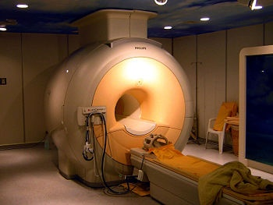
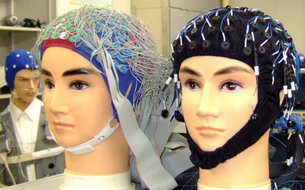
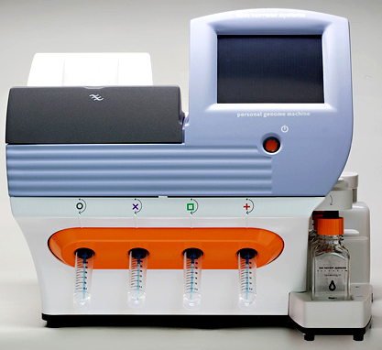
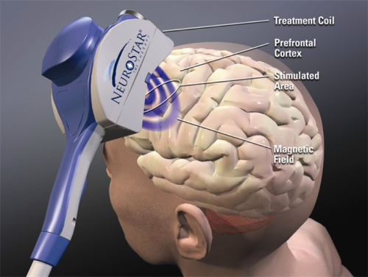
Our toys

Slide 5
DI NCU Projects:NCI
Neurocognitive Informatics: understanding complex cognition => creating algorithms that work in similar way.
Computational creativity, insight, intuition, imagery.
Imagery agnosia, especially imagery amusia.
Neurocognitive approach to language, word games.
Medical information retrieval, analysis, visualization.
Comprehensive theory of autism, ADHD, phenomics.
Visualization of high-D trajectories, EEG signals, neurofeedback.
Brain stem models & consciousness in artificial systems.
Geometric theory of brain-mind processes.
Infants: observation, guided development.
Neural determinism, free will & social consequences.

Slide 6
DI NCU Projects: CI
Google W. Duch => List of projects, talks, papers
Computational intelligence (CI), main themes:
Foundations of computational intelligence: transformation based learning, k-separability, learning hard boole’an problems.
Novel learning: projection pursuit networks, QPC (Quality of Projected Clusters), search-based neural training, transfer learning or learning from others (ULM), aRPM, SFM ...
Understanding of data: prototype-based rules, visualization.
Similarity based framework for metalearning, heterogeneous systems, new transfer functions for neural networks.
Feature selection, extraction, creation of enhanced spaces.
General meta-learning, or learning how to learn, deep learning.

Slide 8
Few Initiatives
IEEE Computational Intelligence Society Task Force (J. Mandziuk & W. Duch), Towards Human-like Intelligence.
World Congress of Computational Intelligence 2014 Special Session: Towards Human-like Intelligence (A-H Tan, J. Mandziuk, W .Duch)
Brain-Mind Institute School (25.06-3.08.2012), International Conference on Brain-Mind (ICBM) and Brain-Mind Magazine (Juyang Weng, Michigan SU).
AGI: conference, Journal of Artificial General Intelligence comments on Cognitive Architectures and Autonomy: A Comparative Review (special issue, eds. Tan A-H, Franklin S, Duch W).
BICA: Annual International Conf. on Biologically Inspired Cognitive Architectures, 3rd Annual Meeting of the BICA Society, Palermo, Italy, 31.10- 3.11.2012

Slide 9
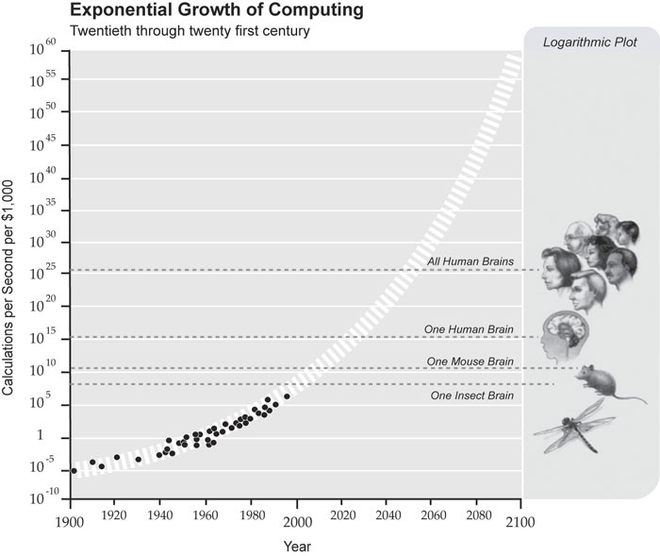
Exponential growth of power
From R. Kurzweil,
The Law of Accelerating Returns
By 2020 PC computers
will match the raw speed of brain operations!
What about organization of info flow?

Slide 10
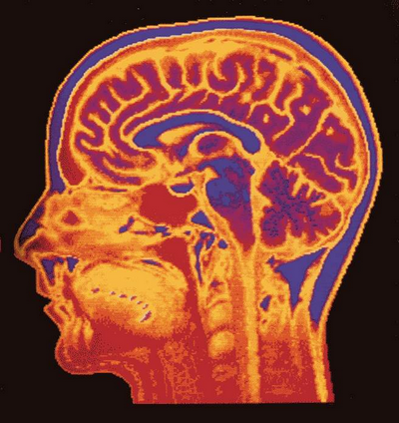
Understanding by creating brains
“Here, we aim to understand the brain to the extent that we can make humanoid robots solve tasks typically solved by the human brain by essentially the same principles. I postulate that this ‘Understanding the Brain by Creating the Brain’ approach is the only way to fully understand neural mechanisms in a rigorous sense.”
M. Kawato, From ‘Understanding the Brain by Creating the Brain’ towards manipulative neuroscience. Phil. Trans. R. Soc. B 27 June 2008 vol. 363 no. 1500, pp. 2201-2214
Humanoid robot may be used for exploring and examining neuroscience theories about human brain.
Engineering goal: build artificial devices at the brain level of competence.

Slide 11
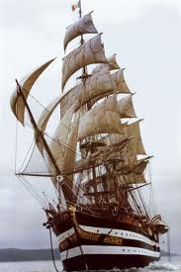
EU FP7 FET Flagships
Initially 26 projects, reduced to 6 candidates for FET (Future Emerging Technologies) Flagships Projects, each planned for 10 year, 1 billion €.
2 winning projects announced in 2012.
HBP-PS: The Human Brain Project, understanding the way the human brain works. Could be the key to enabling a whole range of brain related or inspired developments in ICT, as well as having transformational implications for neuroscience and medicine. “Mind and brain” project submitted by our group lost to HBP.
Graphene-CA: Graphene Science and technology for ICT and beyond, electronics, spintronics, photonics, plasmonics …

Slide 12
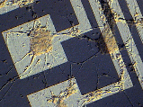
The Great Artificial Brain Race
BLUE BRAIN, HBP: École Polytechnique Fédérale de Lausanne, in Switzerland, use an IBM supercomputer to simulate minicolumn.
C2: 2009 IBM Almaden built a cortical simulator on Dawn, a Blue Gene/P supercomputer at Lawrence Livermore National Lab. C2 simulator re-creates 10⁹ neurons connected by 10¹³ synapses, small mammal brain.
NEUROGRID: Stanford (K. Boahen), developing chip for ~ 10⁶ neurons and ~ 10¹⁰ synapses, aiming at artificial retinas for the blind.
IFAT 4G: Johns Hopkins Uni (R.Etienne-Cummings) Integrate and Fire Array Transceiver, over 60K neurons with 120M connections, visual cortex model.
Brain Corporation: San Diego (E. Izhakievich), neuromorphic vision.
BRAINSCALES: EU neuromorphic chip project, FACETS, Fast Analog Computing with Emergent Transient States, now BrainScaleS, complex neuron model ~16K synaptic inputs/neuron, integrated closed loop network-of-networks mimicking a distributed hierarchy of sensory, decision and motor cortical areas, linking perception to action.

Slide 13
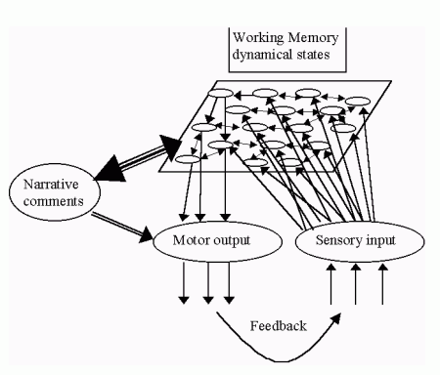
How brains differ from computers
Brain states are physical, spatio-temporal states of neural tissue.
I can see, hear and feel only my brain states! Ex: dreams, change blindness.
Cognitive processes operate on highly processed sensory data.
Redness, sweetness, itching, pain ... are all physical states of brain tissue.
In contrast to computer registers,
brain states are dynamical, alive!
They contain in themselves many associations, relations.
Inner world is real! Mind events flow from interpretation of sequences of brain states.
Computers and robots do not have such dynamic working memory.

Slide 14
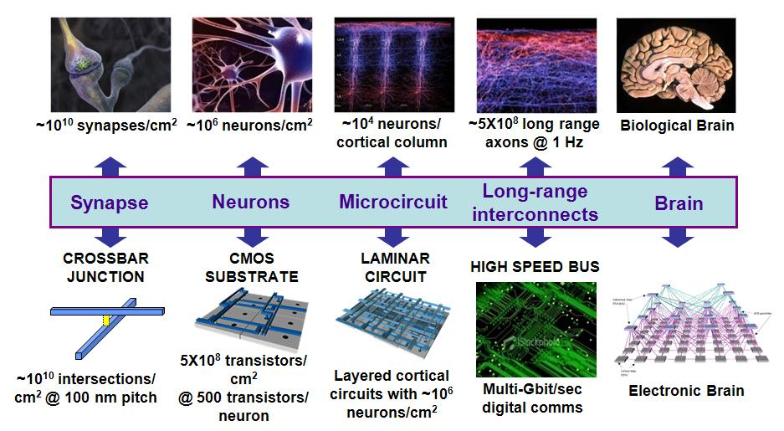
From brains to machines
Source: DARPA Synapse project

Slide 15
Space/time scales
10⁻⁴ m Neurons 10⁻³ s
10⁻⁶ m Synapses 10⁻⁴ s
10⁻¹⁰ m Molecules 10⁻¹⁰ s
10⁻³ m Microcircuits 10⁻² s
10⁻² m Maps 10⁻¹ s
0.1 m Brain systems 1 s
CNS/ANS/PNS 1 m, 0.1-10 s
10⁻⁸ m Ion channel 10⁻³ s
Spatiotemporal resolution:
spatial scale: 10 orders of magnitude, from 10⁻¹⁰ m to 1 m.
temporal scale: 10 or more orders of magnitude, from 10⁻¹⁰ s to 1 s.
Architecture:
hierarchical and modular
ordered in large scale, chaotic in small;
specific projections: interacting regions wired to each other;
diffused: regions interact through hormones and neurotransmitters;
functional: subnetworks dedicated to specific tasks.

Slide 16
Phenomics
Phenomics is the branch of science concerned with identification and description of measurable physical, biochemical and psychological traits of organisms. Genom, proteom, phenom, interactom, exposome, virusom … omics.org has a list of over 400 various …omics. Human Phenome Project, since 2003. Human Epigenome Project, since 2003. Human Connectome Project, since 2009. Developing Human Connectome Project, UK 2013
Consortium for Neuropsychiatric Phenomics, since 2008 investigates phenotypes of people suffering from serious mental disorders at all possible levels.
Can neurocognitive phenomics be developed to understand general behavior of people?

Slide 17
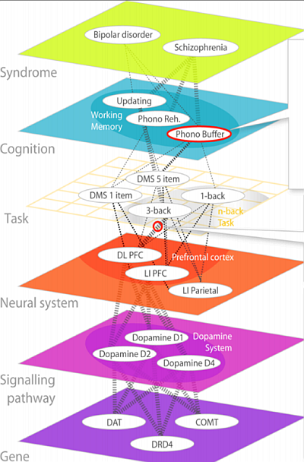
Neuropsychiatric Phenomics in 6 Levels
According to The Consortium for Neuropsychiatric Phenomics (CNP) http://www.phenomics.ucla.edu
From genes to molecules to neurons and their systems to tasks, cognitive subsystems and syndromes.
Neurons and networks are right in the middle of this hierarchy.

Slide 18
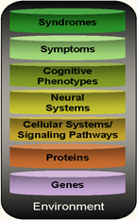
Strategy for Phenomics Research
The Consortium for Neuropsychiatric Phenomics: research should provide bridges between all levels, one at a time, from environment to syndromes.
Strategy: identify biophysical parameters of neurons required for normal neural network functions and leading to abnormal cognitive phenotypes, symptoms and syndromes.
Create models of cognitive function that may reflect some of the symptoms of the disease, ex. problems with attention, relating them to model biophysical properties of neurons.
Result: mental events at the network level are linked to neurodynamics and to low-level neural properties. Ex: why drugs that stimulate the brain help in ADHD case? Relation of ASD/ADHD symptoms to neural accommodation.

Slide 19
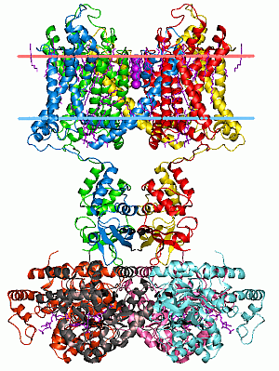
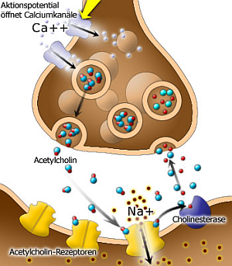
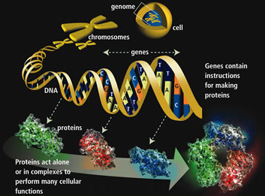
From Genes to Neurons
Genes => Proteins => receptors, ion channels, synapses => neuron properties, networks, neurodynamics => cognitive phenotypes, abnormal behavior, syndromes.

Slide 20
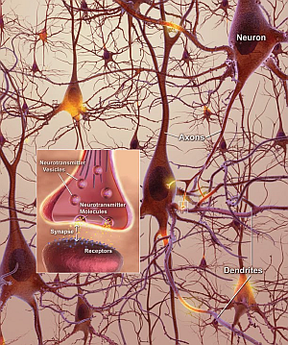
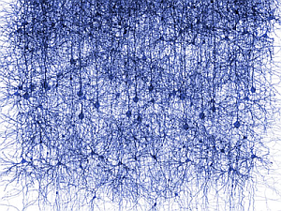
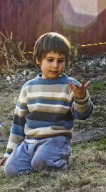
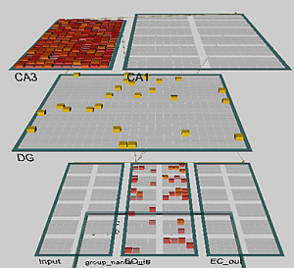
From Neurons to Behavior
Genes => Proteins => receptors, ion channels, synapses => neuron properties, networks
=> neurodynamics => cognitive phenotypes, abnormal behavior!

Slide 21
Neurocognitive Phenomics
Phenotypes may be described at many levels. Here from top down we have education, psychiatry & psychology,
neurophysiology, neural networks,
biology & neurobiology,
biophysics, biochemistry & bioinformatics.
Neurocognitive phenomics is even greater challenge than neuropsychiatric phenomics.
Effects are more subtle but this is the only way to understand fully human/animal behavior.
Learning styles, strategies
Learning styles
Memory types,
attention …
Cognition
Sensory & motor activity, N-back …
Tasks, reactions
Specialized brain areas, minicolumns
Neural networks
Many types of neurons
Synapses, neurons & glia cells
Neurotransmitters & modulators
Signaling pathways
Genes & proteins, brain bricks
Genes, proteins, epigenetics

Slide 22
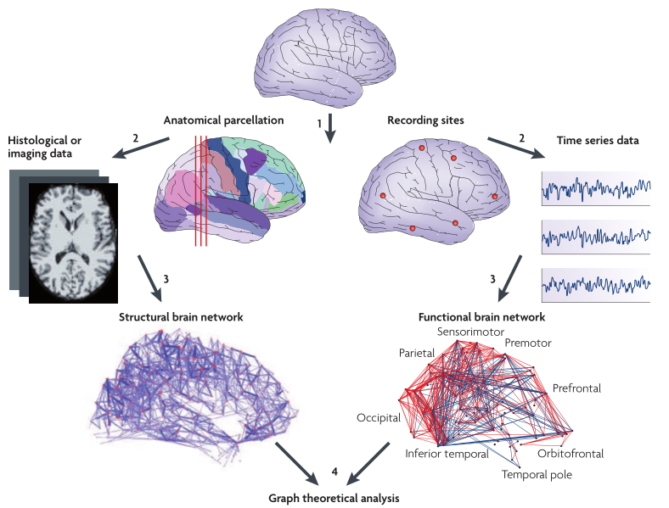
Structure and function
Notes:
Ed Bullmore and Olaf Sporns, Complex brain networks: graph theoretical analysis of structural and functional systems. Nature Reviews Neuroscience 10, 186-198 (March 2009) | doi:10.1038/nrn2575

Slide 23
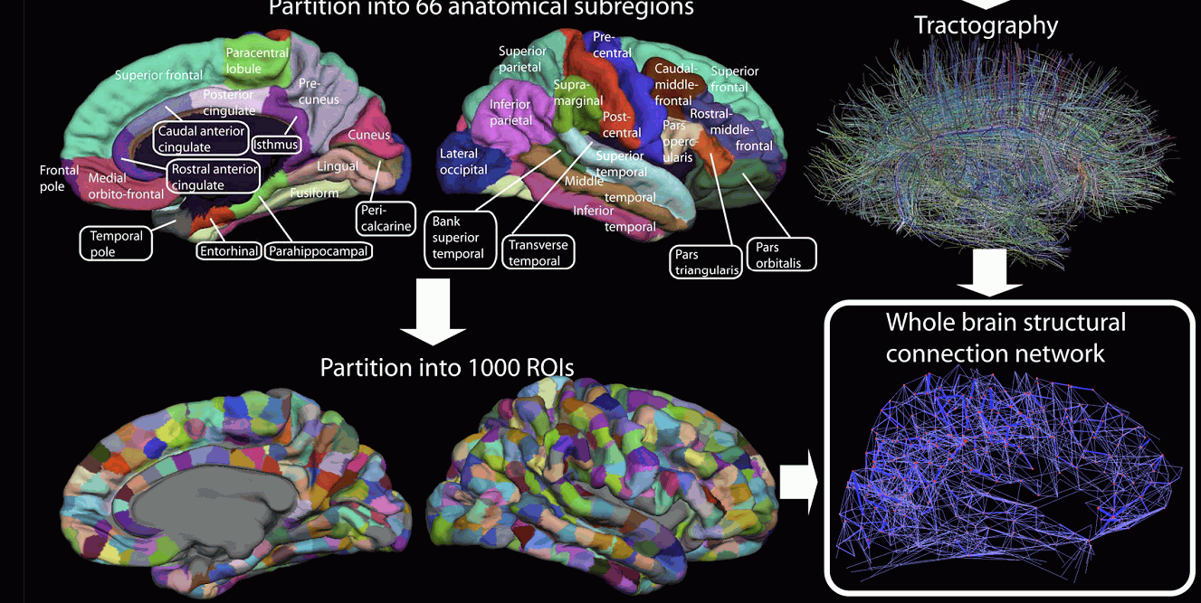
Connectome Project
Brain-based representations of concepts based on distribution of activity over 1000 ROIs should be possible.

Slide 24
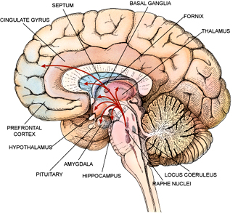
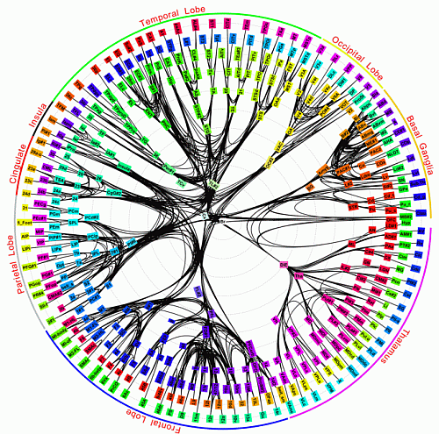
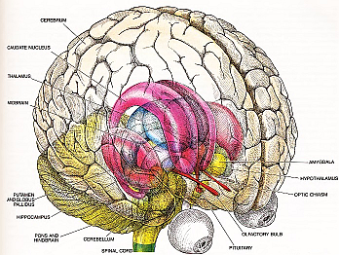
Modules: core brain
Connectivity of 383 regions in macaque brain; Modha & Singh, PNAS 2010.

Slide 25
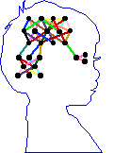
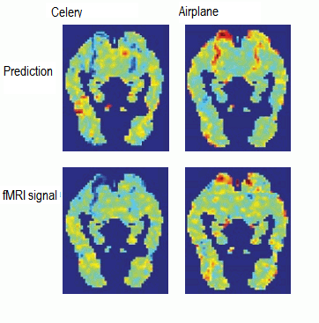
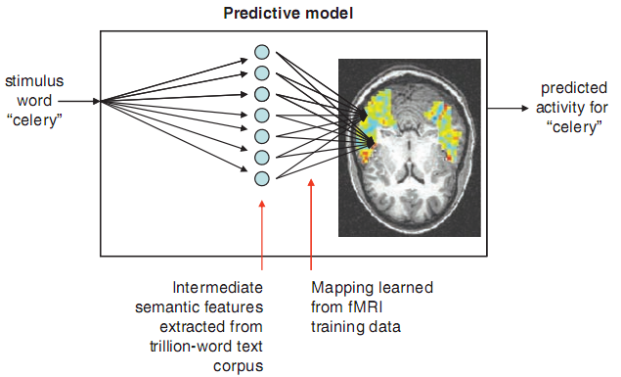
Private thoughts?
Predicting Human Brain Activity Associated with the Meanings of Nouns," T. M. Mitchell et al, Science, 320, 1191, May 30, 2008
Clear differences between fMRI brain activity when people read and think about different nouns.
Reading words and seeing the drawing invokes similar brain activations, presumably reflecting semantics of concepts.
Although individual variance is significant similar activations are found in brains of different people, a classifier may still be trained on pooled data.
Model trained on ~10 fMRI scans + very large corpus (10¹²) predicts brain activity for over 100 nouns for which fMRI has been done.
Overlaps between activation of the brain for different words may serve as expansion coefficients for word-activation basis set.
In future: I may know what you’ll think before you will know it yourself! Intentions may be known seconds before they become conscious!

Slide 26
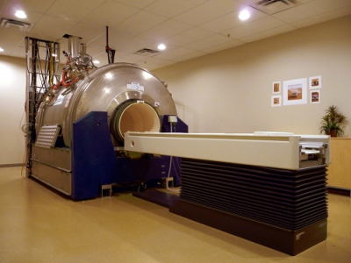
Looking inside
Scanner fMRI 4 Tesla
S. Nishimoto et al. Current Biology 21, 1641-1646, 2011

Slide 27
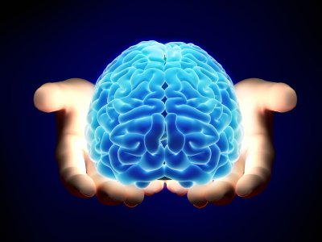
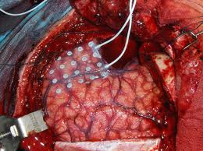
Blurred image?
Just give us access to your cortex, open your skulls, please.
And if you do …

Slide 28
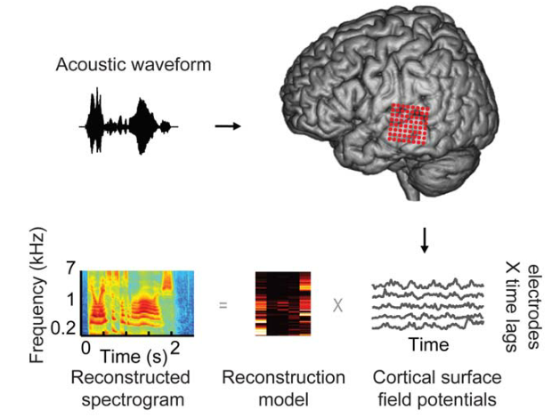
Hearing your thoughts
Spectrogram-based reconstruction of the same speech segment, linearly decoded from a set of electrodes.
Notes:
Spectrogram reconstruction. (A) Top: spectrogram of six isolated words (deep, jazz, cause) and pseudowords (fook, ors, nim) presented aurally to an individual participant. Bottom: spectrogram-based reconstruction of the same speech segment, linearly decoded from a set of electrodes. Purple and green bars denote vowels and fricative consonants, respectively, and the spectrogram is normalized within each frequency channel for display. (B) Single trial high gamma band power (70–150 Hz, gray curves) induced by the speech segment in (A). Recordings are from four different STG sites used in the reconstruction. The high gamma response at each site is z-scored and plotted in standard deviation (SD) units. Right panel: frequency tuning curves (dark black) for each of the four electrode sites, sorted by peak frequency and normalized by maximum amplitude.
Red bars overlay each peak frequency and indicate SEM of the parameter estimate. Frequency tuning was computed from spectro-temporal receptive
fields (STRFs) measured at each individual electrode site. Tuning curves exhibit a range of functional forms including multiple frequency peaks
(Figures S1B and S2B). (C) The anatomical distribution of fitted weights in the reconstruction model. Dashed box denotes the extent of the electrode
grid (shown in Figure 1). Weight magnitudes are averaged over all time lags and spectrogram frequencies and spatially smoothed for display.
Nonzero weights are largely focal to STG electrode sites. Scale bar is 10 mm.
doi:10.1371/journal.pbio.1001251.g002 Brian N. Pasley et al. PLOS Biology 2012

Slide 29
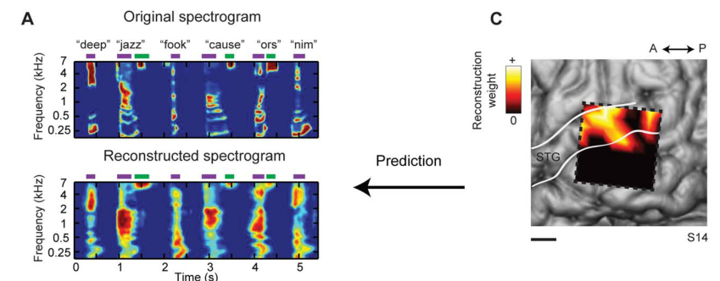
Thought: time, frequency, place, energy
Pasley et al. Reconstructing Speech from Human Auditory Cortex
PLOS Biology 2012
Notes:
Spectrogram reconstruction. (A) Top: spectrogram of six isolated words (deep, jazz, cause) and pseudowords (fook, ors, nim) presented
aurally to an individual participant. Bottom: spectrogram-based reconstruction of the same speech segment, linearly decoded from a set of
electrodes. Purple and green bars denote vowels and fricative consonants, respectively, and the spectrogram is normalized within each frequency
channel for display. (B) Single trial high gamma band power (70–150 Hz, gray curves) induced by the speech segment in (A). Recordings are from four
different STG sites used in the reconstruction. The high gamma response at each site is z-scored and plotted in standard deviation (SD) units. Right
panel: frequency tuning curves (dark black) for each of the four electrode sites, sorted by peak frequency and normalized by maximum amplitude.
Red bars overlay each peak frequency and indicate SEM of the parameter estimate. Frequency tuning was computed from spectro-temporal receptive
fields (STRFs) measured at each individual electrode site. Tuning curves exhibit a range of functional forms including multiple frequency peaks
(Figures S1B and S2B). (C) The anatomical distribution of fitted weights in the reconstruction model. Dashed box denotes the extent of the electrode
grid (shown in Figure 1). Weight magnitudes are averaged over all time lags and spectrogram frequencies and spatially smoothed for display.
Nonzero weights are largely focal to STG electrode sites. Scale bar is 10 mm.
doi:10.1371/journal.pbio.1001251.g002

Slide 30
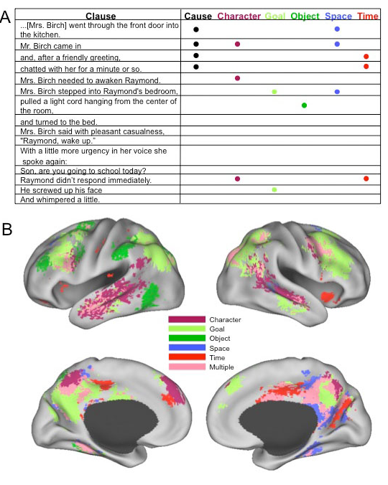
Nicole Speer et al.
Reading Stories Activates Neural Representations of Visual and Motor Experiences.
Psychological Science 2009; 20(8): 989–999.
Meaning: always slightly different, depending on the context, but still may be clusterized into relatively samll number of distinct meanings.

Slide 31
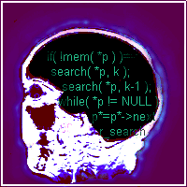
Neurocognitive informatics
Use inspirations from the brain, derive practical algorithms!
My own attempts - see my webpage, Google: W. Duch
Mind as a shadow of neurodynamics: geometrical model of mind processes, psychological spaces providing inner perspective as an approximation to neurodynamics.
Intuition: learning from partial observations, solving problems without explicit reasoning (and combinatorial complexity) in an intuitive way.
Neurocognitive linguistics: how to find neural pathways in the brain.
Creativity in limited domains + word games, good fields for testing.
Duch W, Intuition, Insight, Imagination and Creativity,
IEEE Computational Intelligence Magazine 2(3), August 2007, pp. 40-52

Slide 32
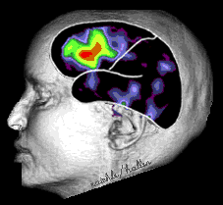
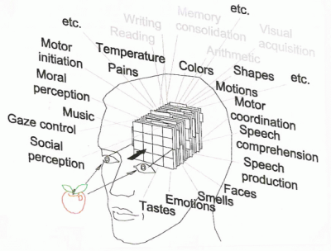
Geometric model of mind
Objective ⬄ Subjective.
Brain ⬄ Mind.
Neurodynamics describes state of the brain activation measured using EEG, MEG, NIRS-OT, PET, fMRI or other techniques.
How to represent mind state?
In the space based on dimensions that have subjective interpretation: intentions, emotions, qualia.
Mind state and brain state trajectory should then be linked together by transformations (BCI).

Slide 33
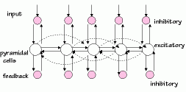
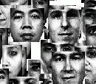
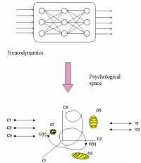
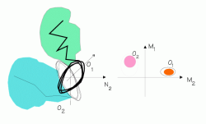
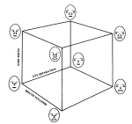
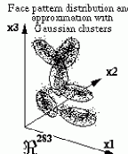
From neurodynamics to P-spaces.
New type of modeling of mental events, I/O relations in psychological spaces.
W. Freeman: model of olfaction in rabbits, 5 types of odors, 5 types of behavior, very complex model in between.
Attractors of dynamics in high-dimensional space => via fuzzy symbolic dynamics allow to define probability densities (PDF) in feature spaces.
Mind objects - created from fuzzy prototypes/exemplars.

Slide 34
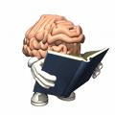
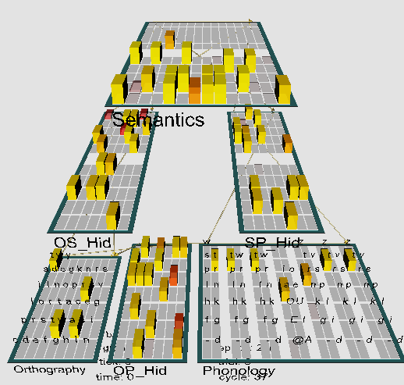
Model of reading & dyslexia
Emergent neural simulator:
Aisa, B., Mingus, B., and O'Reilly, R. The emergent neural modeling system. Neural Networks, 21, 1045-1212, 2008.
3-layer model of reading:
orthography, phonology, semantics, or distribution of activity over 140 microfeatures of concepts.
Hidden layers in between.
Learning: mapping one of the 3 layers to the other two.
Fluctuations around final configuration = attractors representing concepts.
How to see properties of their basins, their relations?

Slide 35
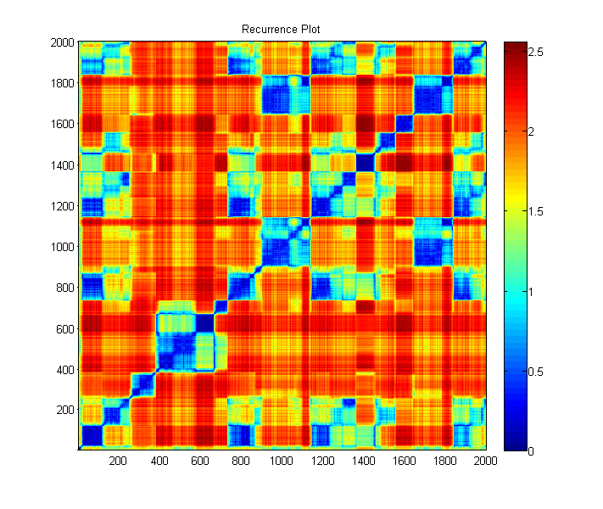
„Gain”: trajectory of semantic activations quickly changes to new prototype synchronized activity, periodically returns.

Slide 36
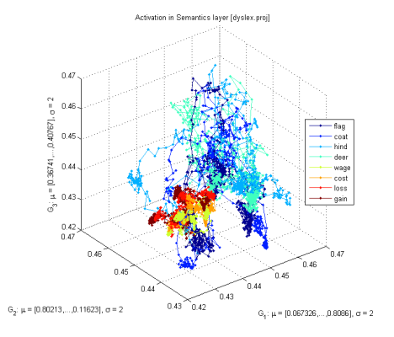
Attractors
Attention results from:
inhibitory competition,
bidirectional interactive processing,
multiple constraint satisfaction.
Basins of attractors: input activations {LGN(X)}=> object recognition
Normal case: relatively large, easy associations, moving from one basin of attraction to another, exploring the activation space.
Without accommodation (voltage-dependent K⁺ channels): deep, narrow basins, hard to move out of the basin, associations are weak.
Accommodation: basins of attractors shrink and vanish because neurons desynchronize due to the fatigue; this allows other neurons to synchronize, leading to quite unrelated concepts (thoughts).

Slide 37
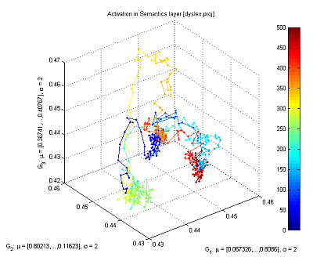
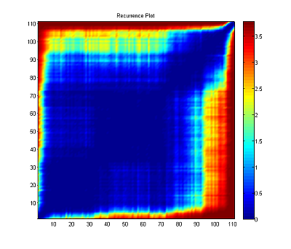
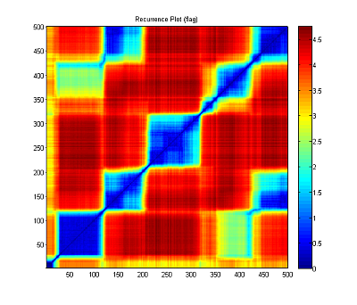
Recurrence plots
Starting from the word “flag”, with small synaptic noise (var=0.02), the network starts from reaching an attractor and moves to another one (frequently quite distant), creating a “chain of thoughts”.
Same trajectories displayed with recurrence plots, showing roughly 5 larger basins of attractors and some transient points.

Slide 38
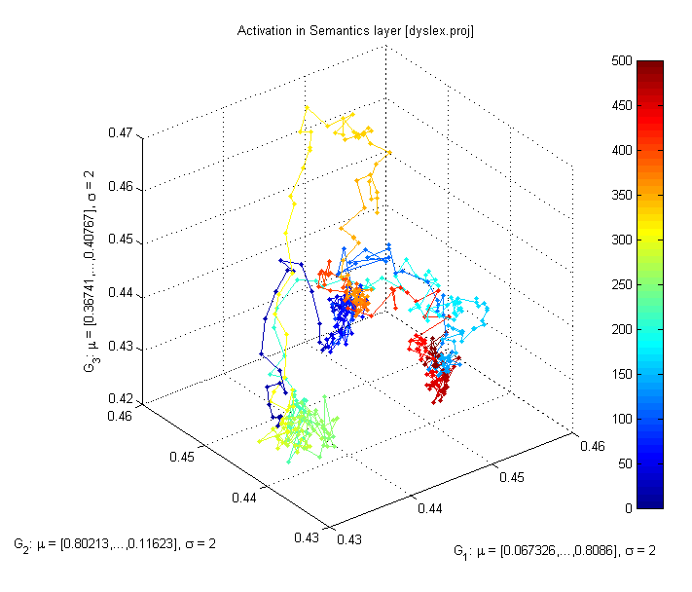
Normal-ADHD
All plots for the flag word, different values of b_inc_dt parameter in the accommodation mechanism, b_inc_dt = 0.01 & b_inc_dt = 0.02
b_inc_dt = time constant for increases in intracellular calcium which builds up slowly as a function of activation.
http://kdobosz.wikidot.com/dyslexia-accommodation-parameters

Slide 39
Normal-Autism
All plots for the flag word, different values of b_inc_dt parameter in the accommodation mechanism. b_inc_dt = 0.01 & b_inc_dt = 0.005
b_inc_dt = time constant for increases in intracellular calcium which builds up slowly as a function of activation.
http://kdobosz.wikidot.com/dyslexia-accommodation-parameters

Slide 40
Neurocognitive reps.
How to approach modeling of word (concept) w representations in the brain? Word w = (w_{f},w_{s}) has
phonological (+visual/graphical) component w_{f}, word form;
extended semantic representation w_{s}, word meaning;
is always defined in some context Cont (enactive approach).
Ψ(w,Cont,t) evolving prob. distribution (pdf) of brain activations. Hearing or thinking a word w, or seeing an object labeled as w adds to the overall brain activation in a non-linear way.
How? Spreading activation in neural spaces, maximizing overall self-consistency, mutual activations, meanings that don’t fit to current context are automatically inhibited. Result: almost continuous variation of word meaning.
This process is rather difficult to approximate using typical knowledge representation techniques, such as connectionist models, semantic networks, frames or probabilistic networks, or logical schemes.

Slide 41
How to become an expert?
Textbook knowledge in medicine: detailed description of all possibilities.
Effect: neural activation flows everywhere and correct diagnosis is impossible. Correlations between observations forming prototypes are not firmly established. Expert has correct associations.
Example: 3 diseases, clinical case description, MDS description.
System that has been trained on textbook knowledge.
Same system that has learned on real cases.
Experienced expert that has learned on real cases.
Conclusion: abstract presentation of knowledge in complex domains leads to poor expertise, random real case learning is a bit better, learning with real cases that cover the whole spectrum of different cases is the best.
I hear and I forget.
I see and I remember.
I do and I understand.
Confucius, -500 r.

Slide 42
Internalization of environment
Episodes are remembered and serve as reference points, if observations are unbiased they reflect reality.

Slide 43
Extreme plasticity
Brain plasticity (learning) is increased if long, Slow strong emotions are involved. Followed by depressive mood it leads to severe distortions, false associations, simplistic understanding.

Slide 44
Conspiracy views
Illuminati, masons, Jews, UFOs, or twisted view of the world leaves big holes and admits simple explanations that save mental energy, creating „sinks” that attract many unrelated episodes.

Slide 45
Learning styles
David Kolb, Experiential learning: Experience as the source of learning and development (1984), and Learning Styles Inventory.

Slide 46
Connectome and learning styles
Simple connectome models may help to connect and improve learning classification of the styles.
S, Sensory level, occipital, STS, and somatosensory cortex;
C, central associative level, abstract concepts that have no sensory components,
mostly parietal, temporal and prefrontal lobes.
M=Motor
C=Central
World
S=Sensory
M, motor cortex, motor imagery & physical action. Frontal cortex, basal ganglia.
Even without emotion and reward system predominance of activity within or between these areas explains many learning phenomena.

Slide 47
Learning styles 1st D
Kolb perception-abstraction: coupling within sensory S⬄S areas, vs. coupling within central C⬄C areas. Strong C=>S leads to vivid imagery dominated by sensory experience. Autism: vivid detailed imagery, no generalization.
M=Motor
C=Central
World
S=Sensory
Attention = synchronization of neurons, limited to S, perception S⬄S strongly binds attention, no chance for normal development. Asperger syndrome strong C=>S activates sensory cortices preventing understanding of metaphoric language.
If central C⬄C processes dominate, no vivid imagery but efficient abstract thinking is expected - mathematicians, logicians, theoretical physicist, theologians and philosophers ideas.

Slide 48
Learning styles 2nd D
Kolb passive-active dimension, observation – experimentation: motor-central processes M⬄C, sensory-motor processes M⬄S.
Autistic people: processes at the motor level M⬄M, leads to repetitive movements, echolalia.
M=Motor
C=Central
World
S=Sensory
The Learning Styles Inventory is a tool to determine learning style. Divides people into 4 types of learners:
divergers (concrete, reflective),
assimilators (abstract, reflective),
convergers (abstract, active),
accommodators (concrete, active).

Slide 49
4 styles and more
Assimilators think and watch: prone to abstract thinking, reflective observation, inductive reasoning due to strong connections S=>C and within C⬄C, weak connections from S=>M and C=>M.
Convergers combine abstract conceptualization, active experimentation, using deductive reasoning in problem solving. Strong C⬄C and C=>M flow of activity.
Divergers focus on concrete experience S⬄S, strong C⬄S connections and C⬄C activity facilitating reflective observation, strong imagery, novel ideas but weak motor activity.
Accommodators have balanced sensory, motor and central processes and thus combine concrete experience with active experimentation supported by central processes S⬄C⬄M.
Now the idea of learning styles is criticized because there was no theoretical framework behind it, but objective tests of the learning styles may be based on brain activity.

Slide 50
Origin of the learning styles
Connectomes develops before birth and in the first years of life.
Achieving harmonious development is very difficult and depends on low-level (genetic, epigenetic, signaling pathways) processes, but may be influenced by experience and learning.
Excess of low-level (sensory) processes S⬄S.
Poor C⬄C neural connections and synchronization, frontal⬄parietal necessary for abstract thinking, weak functional connections prefrontal lobe ⬄ other areas.
Patterns of activation in the brain differ depending on whether the brain is doing social or nonsocial tasks.
“Default brain network” involves a large-scale brain network (cingulate cortex, mPFC, lateral PC), shows low activity for goal-related actions; strong activity in social and emotional processing, mindwandering, daydreaming.

Slide 51
Creativity with words
The simplest testable model of creativity:
create interesting novel words that capture some features of products;
understand new words that cannot be found in the dictionary.
Model inspired by the putative brain processes when new words are being invented starting from some keywords priming auditory cortex.
Phonemes (allophones) are resonances, ordered activation of phonemes will activate both known words as well as their combinations; context + inhibition in the winner-takes-most leaves only a few candidate words.
Creativity = network+imagination (fluctuations)+filtering (competition)
Imagination: chains of phonemes activate both word and non-word representations, depending on the strength of the synaptic connections. Filtering: based on associations, emotions, phonological/semantic density.
discoverity = {disc, disco, discover, verity} (discovery, creativity, verity) digventure ={dig, digital, venture, adventure} new!
Server: http://www.braingene.yoyo.pl

Slide 52
Abstract thinking
G. Marcus et al, “Rule learning by seven-month-old infants”, Science 1999.
7-month old babies habituated for 2 minutes with sentences like ga ti ga, li na li, of the ABA structure, recognize that wo fe wo has correct grammatical structure but wo wo fe does not.
Intelligence: speed of thinking + working memory + synaptic density reflected in ERP structure, later specific structure of connections will increase IQ, decrease creativity.
Strong correlation of IQ between the ability to order two very short sounds, one with higher pitch (ex. J. Drescher, Torun).
Lynn-Flynn effect: IQ grows everywhere in the world, 24 points in USA since 1918, 27 points in UK. Toys and nutrition help to develop better brains?

Slide 53
Infants, syllables
Brains of newborns react to ba/ga/da syllables in the 3–5 day of life in a way that allows for prediction of problems with learning to read years later.

Slide 54
Infants, syllables
Brains of newborns react to ba/ga/da syllables in the 3–5 day of life in a way that allows for prediction of problems with learning to read years later.
D.L. Molfese, 2008 (U. Louisville)

Slide 55
Query
Semantic memory
Applications, search,
20 questions game.
Humanized interface
Store
Part of speech tagger
& phrase extractor
verification
On line dictionaries
Active search and dialogues with users
Parser
Manual

Slide 56
DREAM/HIT – larger view …
Learning
Affective computing
T-T-S synthesis
Behavioral models
Brain models
Speech recognition
HIT projects
Cognitive Architectures
Talking heads
AI
Graphics
Robotics
Cognitive science
Lingu-bots
VR avatars
A-Minds
Knowledge modeling
Info-retrieval
Working Memory
Episodic Memory
Semantic memory

Slide 57
DREAM top-level architecture
Web/text/ databases interface
Text to speech
NLP
functions
Natural input modules
Behavior
control
Talking
head
Cognitive functions
Control of devices
Affective functions
Specialized
agents
DREAM project is focused on perception (visual, auditory, text inputs), cognitive functions (reasoning based on perceptions), natural language communication in well defined contexts, real time control of the simulated/physical head.

Slide 58
Conclusions
So much work to do …
at every level!
Any shortcuts to understanding of human behavior?

Slide 59
Recent conferences: Neuromania, Neurohistory of art, Homo communicativus, Trends in interdisciplinary studies, http://www.kognitywistyka.umk.pl

